Slide 1


Slide 2
938

Slide 3
35,000

Slide 4
Local History
9 Ronald McDonald House
1979
Dr. Samuel Gross, Pediatric Oncologist
Patient’s families identified the need for a facility offering low-cost living

Slide 5
Purpose
“Ronald McDonald House® of Cleveland, Inc. supports families whose children receive treatment at area medical centers by providing a home-like environment and essential resources and services.”
Humanitarian and Social Services
Affordable housing
Families with medically challenged children who are being treated at local area hospitals
Vision – To be recognized for excellence
Caring, Inclusiveness, Quality, Innovation, Teamwork, Trust

Slide 6
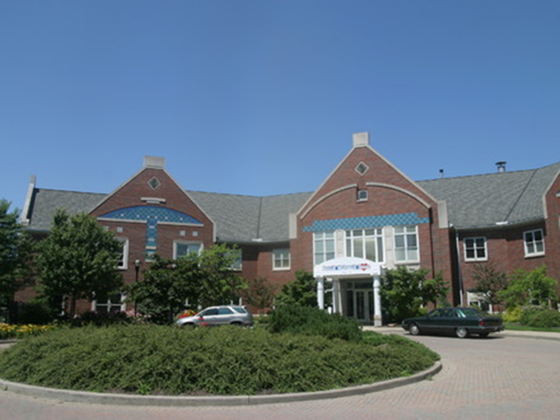
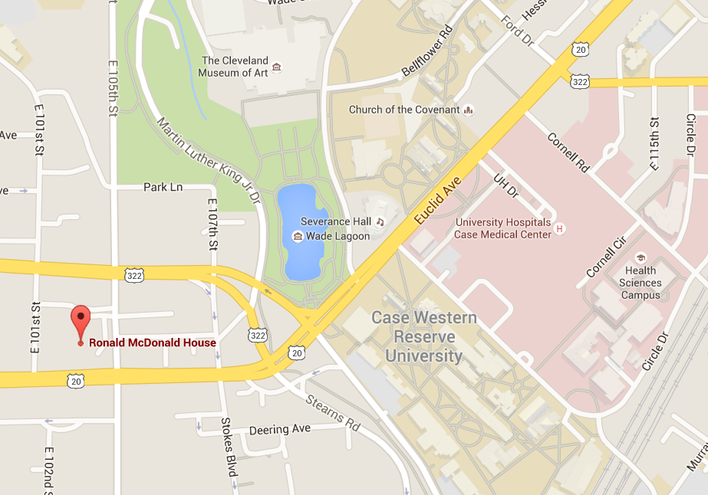
The House
55 Guest rooms
Living areas
Playing areas
Laundry facilities
6 Fully equipped kitchens
2.5 Acres of gardens
Asked for $20/night
Costs $75/night

Slide 7
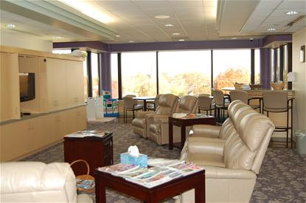
Family Rooms
Extension of the house into the hospitals; allows for escape from the hospital environment while still in the hospital
Free use of kitchen with food, lounge, play area, computer, laundry room, and showers
4 Locations: Rainbow Babies (2006), Cleveland Clinic (2008), Fairview (2009), MetroHealth (2010)
Only RMH in Ohio
75,000 Guests in 2014
MetroHealth Family Room

Slide 8
About Operations
Budget: $2 million
11 full-time and 17 part-time staff
Extremely reliant from general donations (>90%)

Slide 9


Slide 10
What I Found Most Interesting
Start
Fred Hill, Philadelphia Eagle’s tight end
Sick child, leukemia
Wanted to solve a problem: witnessed and experienced the stress that other families were going through
Hill was able to gain McDonald’s support
Financed by McDonald’s Shamrock Shake
1974 – First RMH opened in Philadelphia

Slide 11
What I Found Most Interesting
Expansion
Nonprofit
They are almost completely reliant off of donations
Free service
Yet, 8.46 new homes are opened every year on average
Why?
Because there is such a great need for these programs and services

Slide 12
Would I Become Involved?
YES - They are a great organization
They are financially stable
They are extremely honorable
They are genuinely great people
I’ve actually volunteered at the place occasionally for almost a year.
Yard Work
Played so much Bingo

